Slide 1
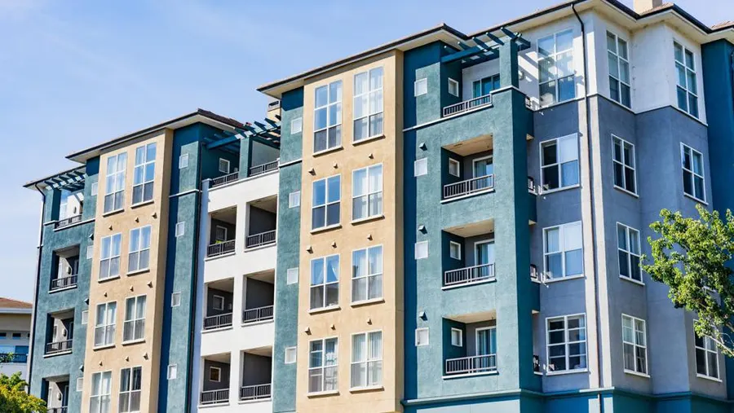
Predicting Apartment Rental Trends:
A Machine Learning Approach
Collaborators: Yara El-Emam ll Zane Huttinga II Kimberly Her II Chinna Maijala
December 16, 2024
University of MN - Data Analytics Bootcamp

Slide 2

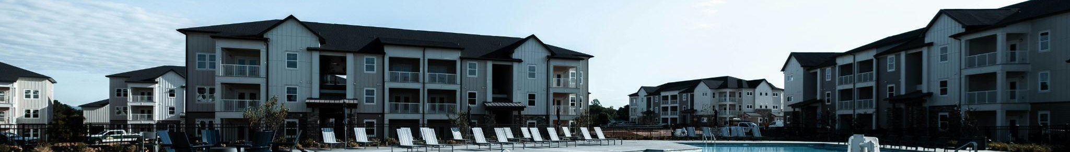
Introduction
We analyzed the Apartments for Rent dataset, sourced from the USA classifieds on the UCI Machine Learning Repository. This dataset comprises 100,000 rows and 22 columns, capturing attributes such as price, square footage, location, and other key features. Our objective is to leverage machine learning techniques, including Linear Regression, Neural Networks, and Random Forest, to evaluate model performance and build predictive models that can be applied for future rental price predictions.

Slide 3
Problem Statement
Problem: The apartment rental market is highly dynamic and difficult to predict.
Need: There’s a demand for data-driven insights that can help renters, landlords, and investors make better decisions.

Slide 4
Data Overview
Key features include:
Price: The rental price of the apartment (target variable).
Square Feet: The size of the apartment in square feet.
Location: Geographical details including latitude, longitude, and state.
Pets Allowed: Information about pet restrictions or permissions.
Date: Year and month extracted from the listing’s posting date.
Data Cleaning 1:
Used Apache Spark to load and preprocess the raw data, including removing delimiters, and subsequently loaded the cleaned data into Pandas for further analysis.
Ensured no missing values in essential columns like price, square feet, and bathrooms.
Encoded categorical variables (e.g., source, category, state) using one-hot encoding.
Mapped boolean columns (e.g., has_photo) to numerical values.
Grouped rare categories for features like pets_allowed and handled unknown values systematically.
Extracted year and month from the date column to simplify temporal analysis.

Slide 5
Data Cleaning 2
• Handled Missing Geographic Data:
• Imputed missing cityname and state columns using reverse geocoding based on latitude and longitude.
• Fully completed the state column and partially filled cityname, enriching location-based insights.
• Transformed Amenities Column:
• Used one-hot encoding to convert text-based, comma-separated amenities (e.g., “Gym, Pool, Parking”) into binary columns.
• Expanded feature space, enabling the model to utilize detailed amenities data effectively.
• Ensured Consistency and Quality:
• Dropped rows with missing values in critical columns after enrichment.
• Validated data integrity to ensure no mismatched or incomplete records were included in the analysis.
• Final Feature Selection:
• Removed irrelevant columns such as id, title, date, source, and currency to focus on meaningful predictors.

Slide 6
Machine Learning

Slide 7
Preprocessing for Machine Learning
Encoding: Applied one-hot encoding to categorical variables
Scaling: Standardized numerical features such as price, square feet, bathrooms, etc., to ensure uniform scaling.
Splitting: Divided the dataset into training (80%) and testing (20%) sets for robust model evaluation.

Slide 8
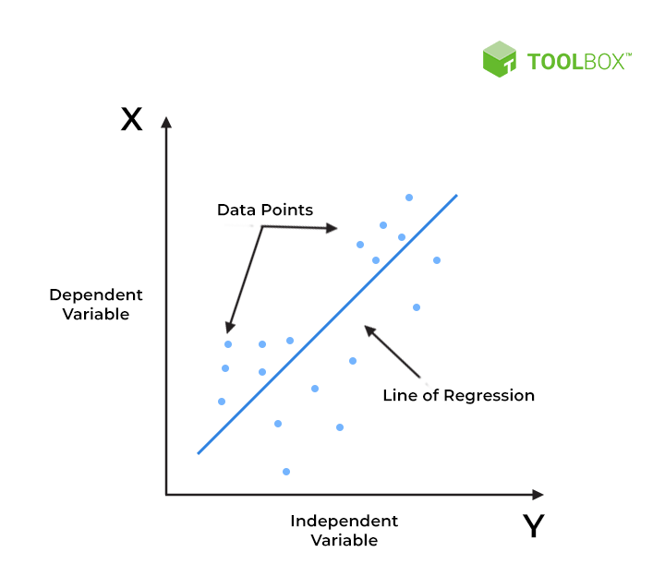
Linear Regression
01
Overview
Performed using scikit-learn’s LinearRegression function.
Fitted to scaled training data (X) and training data (y).
Results:
MSE: 370,387.31
R-squared: 0.4437 44.37%
QUICK TIP
Try rightclicking on a photo and using "Replace Image" to show your own photo.
Source: Spiceworks.com

Slide 9
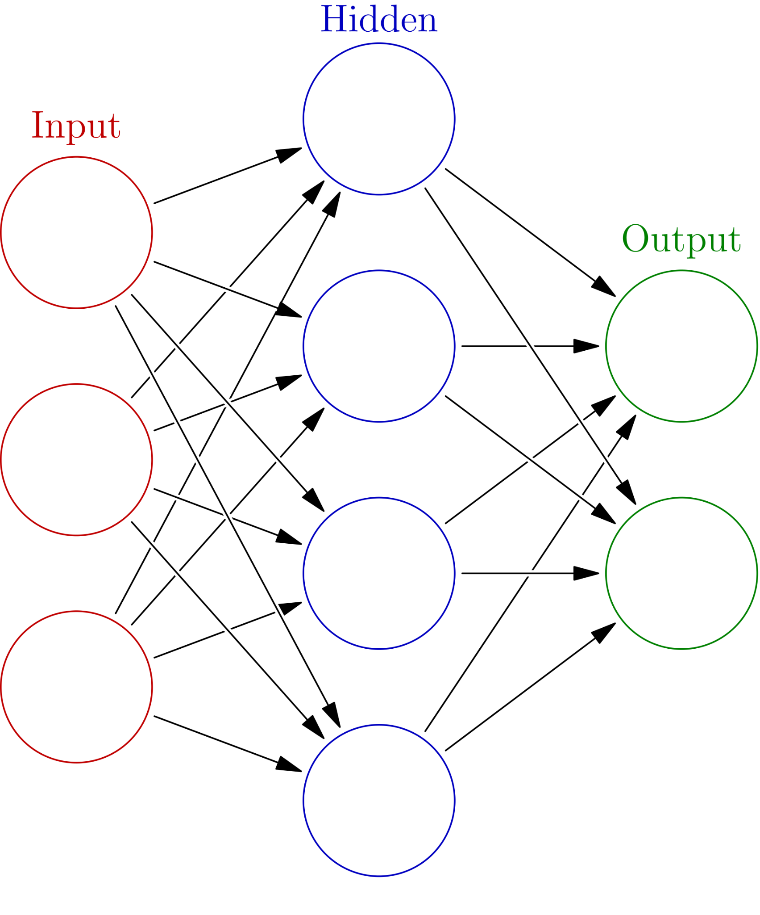
Neural Networks
02
Enhanced model architecture:
This model demonstrated moderate performance, explaining 64.44% of the variability in the target variable. The architecture included:
256 neurons in the input layer,
Dropout layers to prevent overfitting, and
Batch normalization for improved stability.
Results:
MSE: 295,780.94
R-squared: 0.6444 (64.44%)
Optimized model architecture:
Additional regularization techniques (e.g., L2 regularization),
Optimized learning rate, and
More targeted dropout rates.
Results:
MSE: 322,983.44
R-squared: 0.6117 (61.17%)
Source: Wikipedia user Glosser.ca

Slide 10
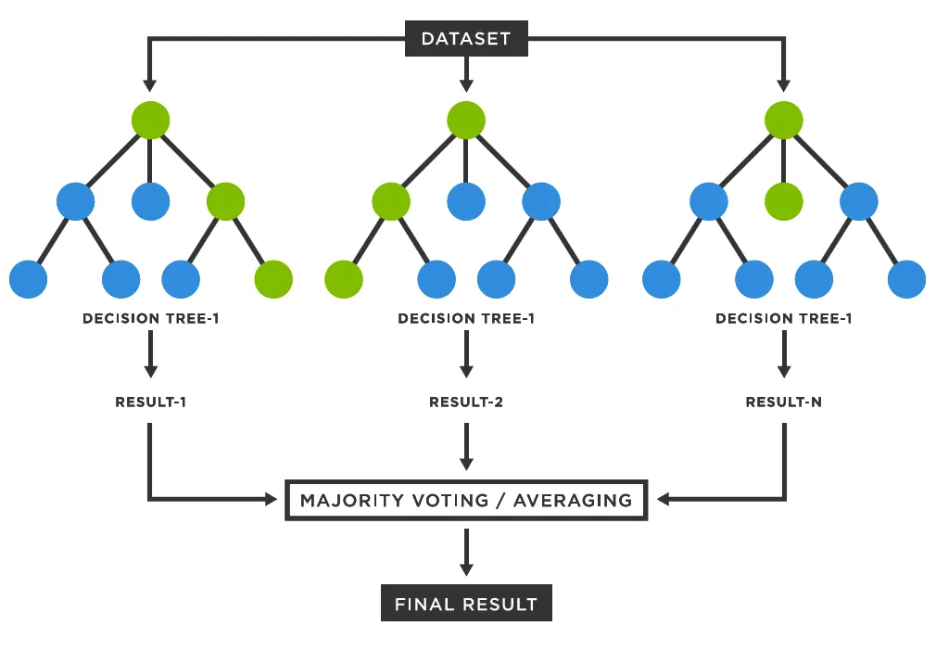
Random Forest Regressor
03
Overview:
Initial Run:
Used the default parameters of the Random Forest Regressor:
Number of Estimators (n_estimators): 100
Maximum Depth (max_depth): None (the tree expands until all leaves are pure or contain less than min_samples_split samples)
Results:
MSE: 129,886.13
R-squared: 0.8049 80.49%
Fine-Tuned Run:
n_estimators: Number of trees in the forest.
max_depth: Maximum depth of each tree.
min_samples_split: Minimum number of samples required to split a node.
min_samples_leaf: Minimum number of samples required in a leaf node.
max_features: Number of features to consider when looking for the best split.
Results:
MSE: 129,631.31
R-squared: 0.8053 80.53%
Source: Medium.com (user Deniz Gunay)

Slide 11
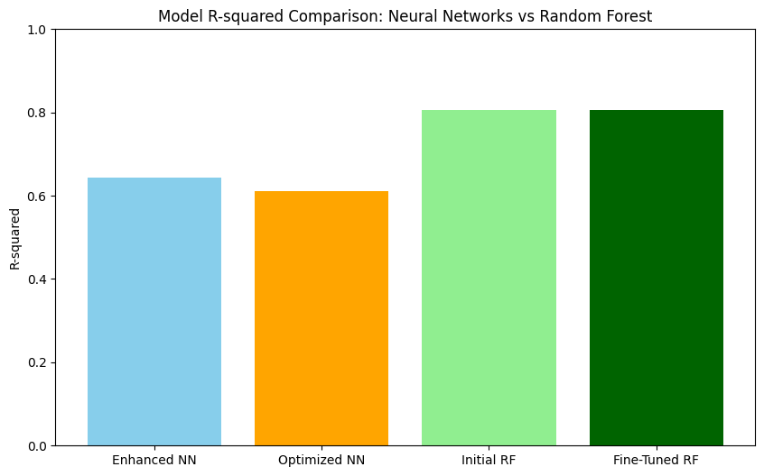
Visualizations - Key Insights
Key Trends: Use Matplotlib

Slide 12






Results & Insights
Model Performance:
Achieved an R-squared of 80.53% with a fine-tuned Random Forest model.
Demonstrated the importance of enriched and consistent data for predictive accuracy.
Impact of Data Enrichment:
Addressing missing geographic information and encoding text-based features enhanced the dataset significantly.
Improved feature space enabled models to leverage granular information, leading to better predictions.
Future Opportunities:
Further exploration of price trends and key factors affecting rent (e.g., location, square footage).
Clustering to identify rental categories and market segmentation.

Slide 13
Conclusion
This project successfully demonstrated the importance of data enrichment and optimization in machine learning. By addressing missing geographic information, encoding amenities, and ensuring consistency, we enhanced the dataset to provide valuable insights for predicting apartment rental prices. The fine-tuned Random Forest model achieved an R-squared of over 0.80, showcasing strong predictive power.
Looking ahead, further analysis could uncover trends in apartment prices over time, key factors influencing rent, and clustering insights to categorize rental types. These additional steps could provide actionable recommendations for renters, investors, and property managers.

Slide 14



Challenges & Limitations
Opportunities
Limitation
01
While the enriched data improved model performance, the models do not account for temporal trends or market fluctuations over time. Incorporating temporal data could help identify seasonal patterns and enhance predictions.
03
Challenge
Handling missing values in the cityname and state columns. Using reverse geocoding to fill in missing data added computational complexity and increased processing time, but it was necessary to ensure location-based insights were accurate.
02
Future work could explore clustering techniques to identify apartment types or rental categories and investigate key factors affecting rent, such as location and amenities, for deeper insights into rental dynamics.

Slide 15
Thank You.
Questions?

Slide 16
Sources of the dataset: USA classifieds on the UCI Machine Learning Repository
Technologies Used:
- Python Libraries: Pandas, NumPy, Matplotlib, Scikit-learn
- Database: SQL for data retrieval and preprocessing
- Machine Learning Frameworks: Scikit-learn for modeling and evaluation
- Visualization: Matplotlib for data exploration and results visualization
References

